Slide 1

TECNOLÓGICO DE MONTERREY
Practice 1: Setting up the
Stretch Robot Simulator
Robotics and Cyber-Physical Systems Lab

Slide 2


Objectives & Requirements
Key Objectives
System Requirements
• Install and verify the MuJoCo base simulator
• Windows, macOS, or Linux
• Integrate RoboCasa kitchen environments
• uv package manager & Git
• Complete a block stacking teleop challenge
• 5+ GB free disk space

Slide 3
Software Installation
Install uv: Use the PowerShell or curl script to get the fast package manager.
Clone Repository: Use --recurse-submodules to pull the digital twin assets.
Commands: git clone https://github.com/SilentSammy/stretch_mujoco_digital_twin
Sync: Run uv sync if you encounter startup errors.

Slide 4

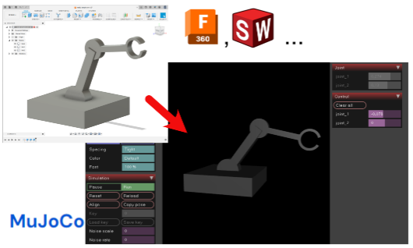
Verification: Base Sim
Launch Command
Run the teleoperation demo:
uv run teleop_demo.py
Expected Result: A MuJoCo viewer opens with the Stretch robot and two colored blocks (blue box & red cylinder).

Slide 5
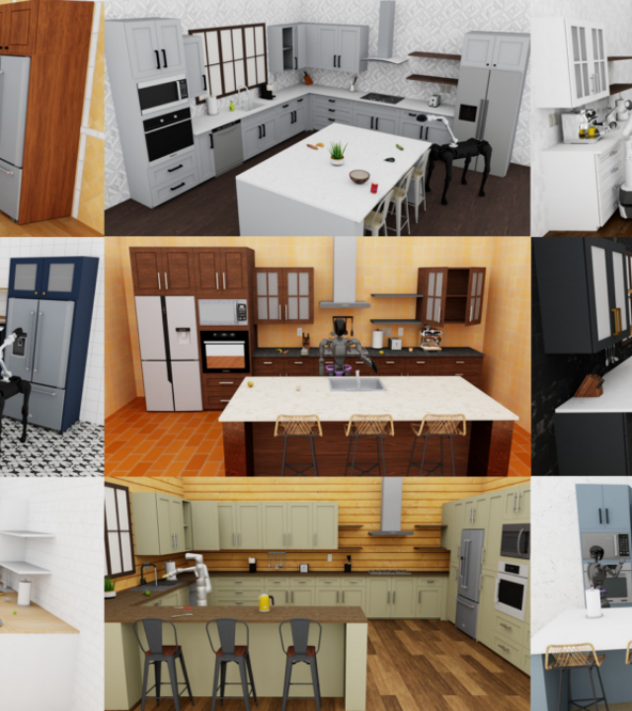
RoboCasa Kitchen
Install: Run the uv pip commands for robocasa and robosuite.
Assets: Note that kitchen assets are ~5GB.
Enable: Set "enabled": true in robocasa_config.json.

Slide 6






Teleoperation & Controls
Base & Lift
Arm & Wrist
Gripper & Cam
WS: Forward/Back
DA: Rotate
ZX: Lift Up/Down
VC: Extend/Retract
L J K I U O: Wrist Yaw, Pitch, Roll
MN: Open/Close
1-5: Toggle Camera Feeds (RGB/Depth)

Slide 7


Evidence & Submission
Final Deliverables
1. Video Link: Demonstrating joint movements with explanations.
2. Screenshots: Kitchen environment (Part 2) and stacked blocks (Part 4).
3. Written Summary: 9 Degrees of Freedom (DOF) descriptions.

Slide 8
Practice 1 Complete
Next Steps: Programmatic Control & Computer Vision
Resource: github.com/SilentSammy/stretch_mujoco_digital_twin

Slide 9



Image Sources
https://yasunori.jp/assets/2024/mjcf/mujoco_article_cover.png
Source: yasunori.jp
https://the-decoder.com/wp-content/uploads/2024/05/RoboCasa-title-1200x675.png
Source: the-decoder.com
https://us.v-cdn.net/6038536/uploads/migrated/UDZWWD0WUQUK/11b7f7ce-3ec8-4aea-85f3-51ca86c47761.png
Source: community.instructure.com

